Slide 1

Web Application Security Fundamentals
By
Shuparbha mainani
Sishir devkota
Raghav Panthi

Slide 2

Introduction to Web Security
Securing web applications is crucial in today's digital landscape. Poor security can lead to devastating consequences, including data breaches, financial losses, and reputational damage.
In this session, we will:
Understand foundational security concepts
Identify common vulnerabilities, threats, and attacks

Slide 3






Foundations of Security
Confidentiality
Integrity
Protecting data from unauthorized access.
Ensuring data is accurate and unaltered.
Availability
Authentication
Ensuring services are accessible when needed.
Verifying user identities.
Authorization
Non-repudiation
Granting access rights to resources.
Preventing denial of actions.

Slide 4
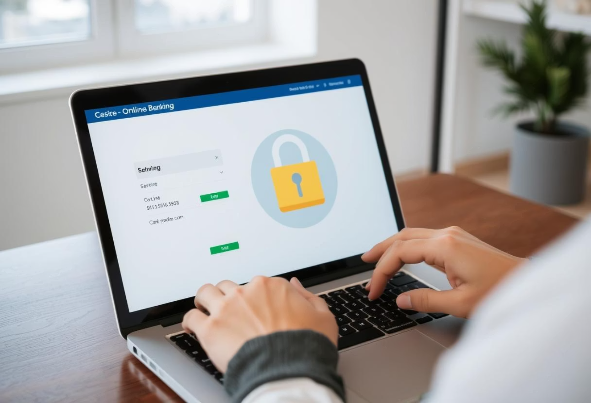
Real-World Example: CIA Triad
Consider an online banking system to illustrate the CIA Triad is a widely used information security model that outlines
three core principles:
Confidentiality
Encrypted transactions protect sensitive financial data from eavesdropping.
Integrity
Transaction logs and checksums ensure that no unauthorized changes are made to your balance or transfers.
Availability
The system is accessible 24/7, allowing users to manage their finances anytime, anywhere.

Slide 5

Understanding Vulnerabilities
A vulnerability is a weakness in a system that can be exploited by an attacker.
Input Validation Flaws
Outdated Software/Libraries
Lack of proper checks on user-submitted data.
Using components with known security holes.
Improper Authentication
Weak or flawed login mechanisms, e.g., default passwords.
The OWASP Top 10 lists the most critical web application security risks.

Slide 6
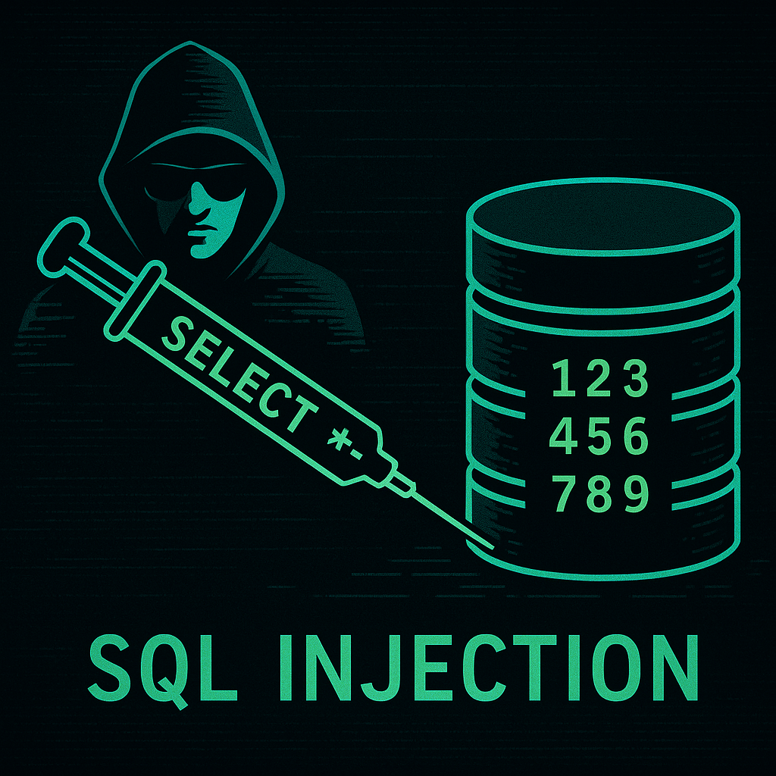
Vulnerability Example: SQL Injection
SQL Injection is a common web security vulnerability that allows attackers to interfere with the queries that an application makes to its database.
Cause
Unvalidated user input is directly used in SQL queries.
Risk
Data leakage, privilege escalation
Mitigation
Use parameterized queries and input sanitization

Slide 7
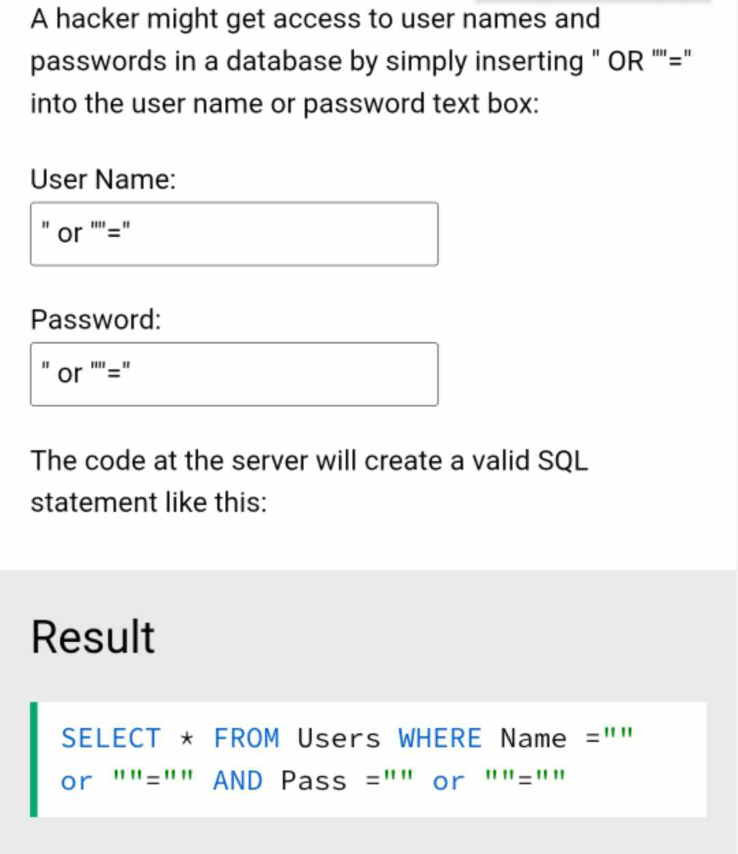
SQL Injection Example

Slide 8


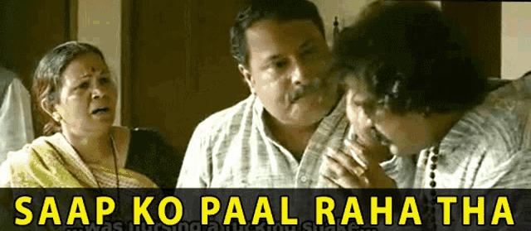





Types of Threats
Threats are potential dangers that can exploit vulnerabilities to compromise a system.
Malicious Insiders
Employees or trusted individuals with harmful intent.
Hackers
External individuals attempting unauthorized access.
Malware and Bots
Automated programs designed to cause harm.
Social Engineering
Manipulating people to gain access to information.
example:honey trap

Slide 9
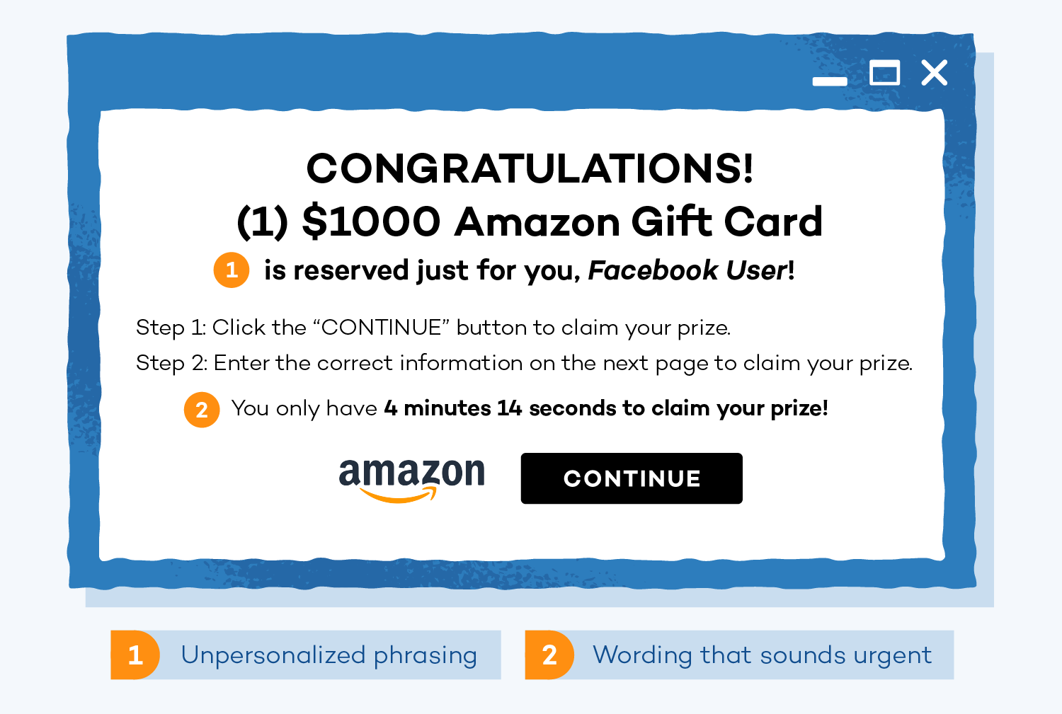
Threat Example: Phishing
A phishing attack involves deceptive emails or messages that direct users to fake login pages.
Goal
To steal user credentials (usernames, passwords, credit card numbers).
Target
Unsuspecting web users.
Method
Crafting convincing, but fraudulent, communications that mimic legitimate entities.

Slide 10

Common Attacks
Attacks are actual events where vulnerabilities are exploited to compromise systems.
1. XSS
2. SQLI
3. CSRF
Cross-Site Scripting
SQL Injection
Cross-Site Request Forgery
Injecting malicious scripts into web pages viewed by other users
. A hacker posts a comment like <script>alert('Hacked!');</script> which runs on other users’ browsers.
Manipulating database queries through unvalidated input.
Example: bypass authentication.
Forcing authenticated users to execute unwanted actions.
A user clicks a malicious link that silently transfers money from their bank account.
4. DoS
5. Brute Force
Denial of Service
Brute Force Login
Overwhelming a system to make it unavailable.
Sending thousands of requests to a website to crash it and make it unavailable.
Systematic trial-and-error to guess credentials.
Trying every possible password like "1234", "admin123", "password" until access is gained.

Slide 11
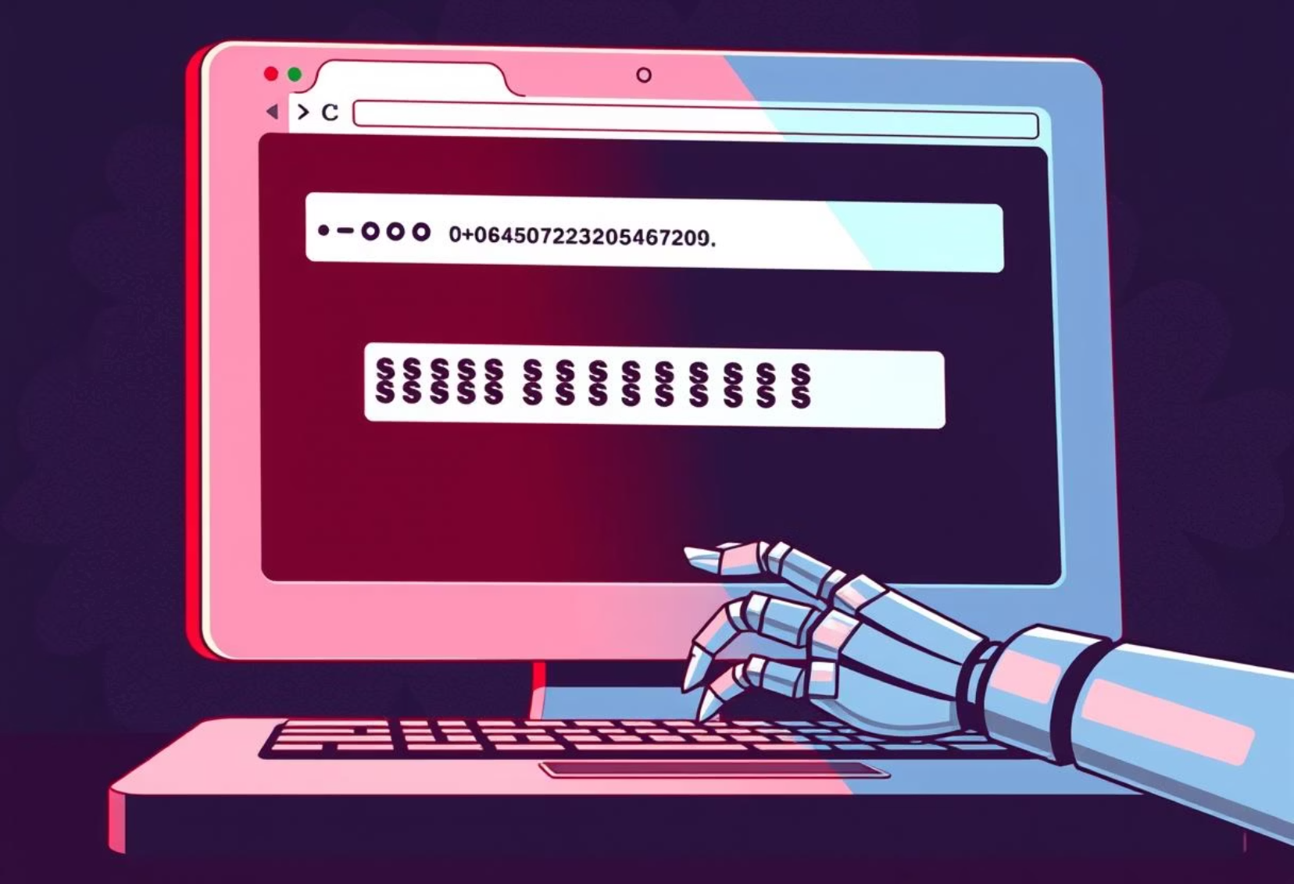
Attack Flow Example: Brute Force Login
A brute force login attack systematically attempts to guess user credentials by trying many combinations.
Tool
Automated scripts rapidly test passwords.
Entry Point
The web application's login page.
Impact
Successful account compromise leading to unauthorized access and data theft./Account hijack

Slide 12


Best Practices
Validate & sanitize inputs
Implement strong authentication (e.g., 2FA)
Regular security audits & code reviews
Keep software and libraries up to date
Use HTTPS & secure cookies

Slide 13


